Slide 1
Time series data & Dispersion
Md. Ismail Hossain Riday

Slide 2

Exercise 1
When the number of years is even:
$$X=2×\left(t−\overline{t}\right)$$
When the number of years is odd:
$$X=\left(t−\overline{t}\right)$$
An agricultural researcher is examining the annual yield (in metric tons) of a specific crop over the past 8 years to understand the trend. The yield data is as follows:
Year | 2000 | 2001 | 2002 | 2003 | 2004 | 2005 | 2006 | 2007
Yield | 50 | 52 | 54 | 56 | 56 | 60 | 62 | 64
Calculate the least squares estimate of the trend line.
Determine the trend value and visualize using appropriate graphical method.
Predict the crop yield for the years 2009, and 2010 using the trend line equation from (a).

Slide 3
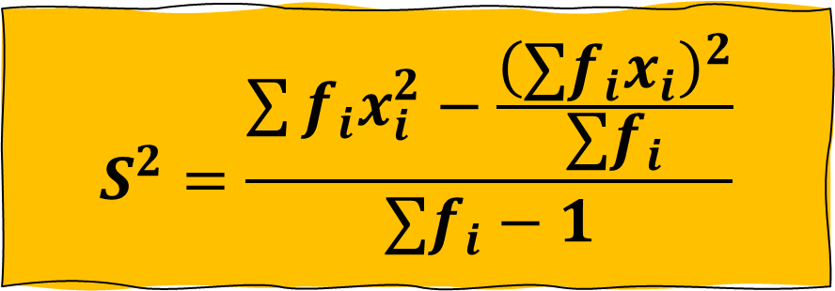
Exercise 2
$$S^{2}=\frac{\sum{{f_{i}x}_{i}^{2}}−\frac{{\left(∑{f_{i}x}_{i}\right)}^{2}}{∑f_{i}}}{∑f_{i}−1}$$
A botanist is studying the lifespan (in weeks) of two species of plants in a controlled environment. The data collected on the lifespan of the two species is summarized as follows:
Lifespan (weeks) | Species A | Species B
0-5 | 3 | 2
5-10 | 8 | 7
10-15 | 12 | 15
15-20 | 10 | 6
20-25 | 5 | 8
Which species has a higher average lifespan?
Calculate standard deviation for both species
Based on the relative measure of dispersion, which species would you prefer to cultivate and why?.

Slide 4
Thank You

